Slide 1
RELIANCE STOCK PREDECTION
TSP- AI ML Fundamentals (Capstone Project)
Presented By:
ADHIKESAVAN R – aut22lee002
Guided By: P RAJA
EDUNET

Slide 2
OUTLINE
Problem Statement
Proposed System/Solution
Algorithm & Deployment
GitHub Link
Project Demo(photos / videos)
Conclusion
Future Scope
References

Slide 3
Problem Statement
The objective of this study is to develop robust and accurate predictive models for forecasting the stock price of Reliance Industries Limited (RIL) utilizing Artificial Intelligence and Machine Learning (AIML) techniques, in conjunction with historical Reliance datasets. Leveraging the vast reservoir of historical data, the primary goal is to construct predictive models capable of providing reliable forecasts of RIL's stock price movements over a specified time horizon.

Slide 4
Proposed Solution
1. Development of accurate and robust predictive models for forecasting RIL and TCS stock prices using AIML techniques.
2. Insights into the key drivers of RIL and TCS stock price movements and their impact on predictive model performance.
3. Comparative analysis of the predictive models, providing stakeholders with valuable insights into the relative performance of each model for RIL and TCS stock prediction

Slide 5
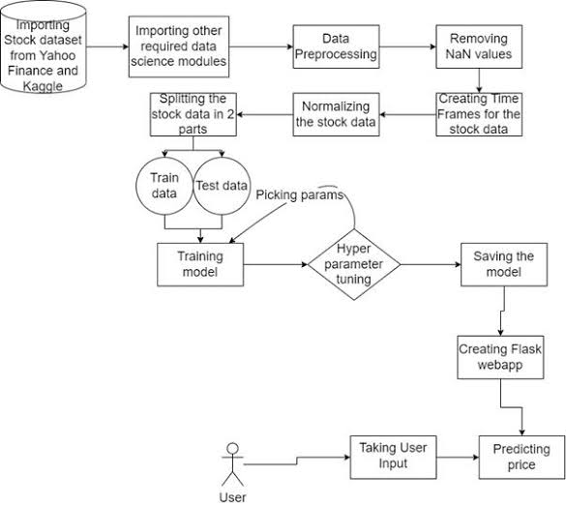
FLOWCHART

Slide 6
GitHub Link
https://github.com/Adhikesavan47/Adhikesavan.R-aut22lee002.git

Slide 7
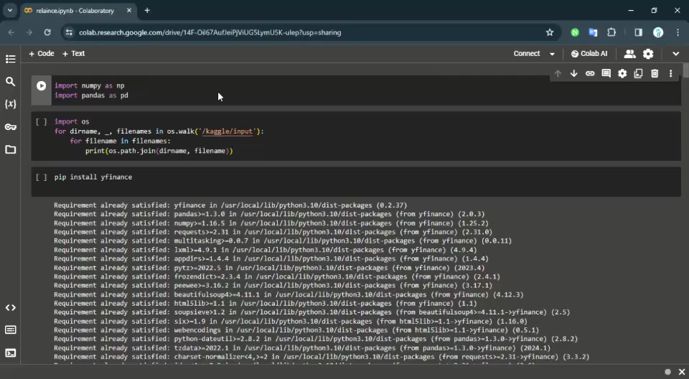
Project Demo(Recorded Video)

Slide 8
Conclusion
The utilization of Artificial Intelligence and Machine Learning (AI/ML) techniques for predicting Reliance stock prices offers significant advantages and holds promising scope for investors and financial analysts. Through the analysis and implementation of AI/ML algorithms, reliable predictions can be made, enabling informed decision-making in the stock market.

Slide 9
Future Scope
Advanced Predictive Analytics: The scope for utilizing more advanced AI/ML techniques such as deep learning, ensemble methods, and reinforcement learning remains vast. These techniques can enhance the accuracy and robustness of Reliance stock price predictions, unlocking new opportunities for investors.
Integration with Other Data Sources: Integrating AI/ML models with a broader range of data sources, including social media sentiment analysis, macroeconomic indicators, and geopolitical events, can further improve prediction accuracy. This integration expands the scope of analysis and provides a more comprehensive understanding of market dynamics.

Slide 10
References
Tissaoui, K., & Aloui, C. (2011). Information flow between stock return and trading volume: The Tunisian stock market. International Journal of Financial Services Management, 5(1), 52–82.

Slide 11
THANK YOU

